Slide 1
Rent Seeking

Slide 2
Anne Krueger: Political Economy of Rent-seeking
Rent-seeking is common
Rent-seeking is often competitive
Especially when it is competitive, it can have substantial negative welfare effects
It results in a divergence between private and social costs of certain activities

Slide 3
Costs of licensing: like those for imported intermediates
Paperwork
Time spent by entrepreneurs in obtaining them
Costs of administrating the licensing system
But Krueger suggests there is also the resource cost of competing for these licenses

Slide 4
Various Allocation rules
Quotas allocated proportionately to domestic production capacity
Pro rata allocation proportionate to firm’s share of total applications (every firm gets inefficiently small amount)
Allocations influenced by expenditures (bribes, meals, trips to the offices of officials)
Entry into government service may be influenced by existence of competition for the licenses

Slide 5
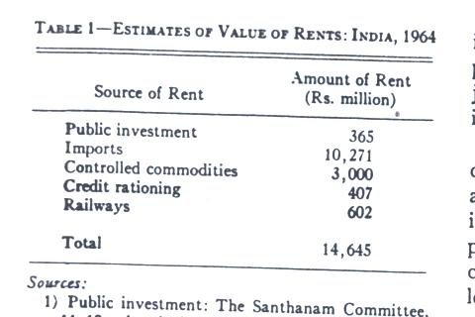
Estimates of Rent-seeking in India These estimates amounted to 7.3% of National Income

Slide 6
Turkey
Imports cif were 6% of GNP in 1968
Value of rents from import licenses 15% of GNP

Slide 7
Model
A = A(L_{A} ) Agricultural output (1)
D = M (Distribution output where M =Imports of consumption goods) (2)
L_{D} = kD Employment in distribution (3)
P_{M} = 1 +P_{D} Distribution markup of imported goods (4)
M= M(p_{M}, A) Demand funct for imports(5)
Food Cons. F =A-M (6)
Lbar= L_{A} +L_{D} +L_{R} (7)

Slide 8
Free Trade Case (free entry into A, D)
A’= p_{D}/k (8) Wage rates equalized in A,D
Equations (1) –(8) allow one to determine A, M, D, F,L_{A},L_{D},p_{M} and p_{D} (L_{R} =0)
Can obtain cons. possibilities curve by substituting (1) and (7) into (6)
F= A(Lbar-kM) –M
Marg. Rate of Trans.: -dF/dM =kA’ +1 >1,(9) d²F/dM²=k²A”<0. Hence locus is concave
Substituting (8) into (9): -dF/dM = 1+ P_{D}

Slide 9
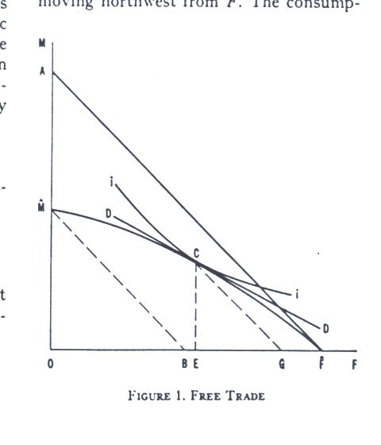
This line would be cons. Possibility
This line = cons. Poss. Locus if D costs =0

Slide 10
Interpretation
FA is cons. Poss. Locus when D costs=0
FM is Cons poss. locus recognizing the distribution costs
C on FM transformation curve is optimum . Slope of this is =slope of indifference curve ii
Production of F is OG of which EG is exported for EC of imports

Slide 11
Import Restriction but w/o Rent seeking
M = Mbar (10)
Relevant system is now (1)-(7) and (10)
Again L_{R} =0 and same variables determined but in different way
Given (10) D determined from (2),
L_{D} from (3), LA from (7), A from (1),
F from (6), pM from (5) and PD from (4)
With (1), (6) and (7) unaffected, solution is again on cons. Poss transformation curve

Slide 12
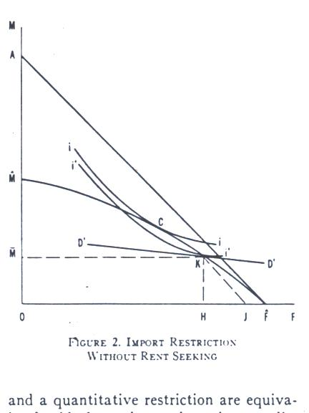
Restriction on Imports is OMbar, Pd rises, prod. , cons., employment of F rise, export decline to HJ =OMbar

Slide 13
Other effects
Employment in D falls, wage in A falls
Wage rate in distribution rises, P_{D} but not necessarily total income of distributors , depending on elasticity of demand for imports
Effects would be similar between tariff and QR (quotas) as long as no rent seeking occurs

Slide 14
Import Restriction with Competitive Rent seeking
A’ = P_{D}Mbar/(L_{D}+L_{R}) (13)
Suppose that some rent-seekers L_{D} are successful and some L_{R} unsuccessful . If so (13) implies risk neutrality
The system now includes (1)-(7), (10) and (13) for L_{R} and the remaining variables
dL_{A} = -dL_{R} Using (6) to substitute into total differential of (1), obtain:
dF=dA=-A’dL_{R} <0 (14)

Slide 15
A and consumption of F reduced
With OMbar same as before, welfare loss will be greater than w/o rent-seeking
Differentiating (5) totally, obtain:
0= M₁dp_{M} +M₂dA (15)
Where M₁ and M₂ are partial derivatives of (5) wrt p_{M} and A
Substituting (4) and (14) and solving for (15) obtain:
dp_{D} =dp_{M}= (M₂/ M₁) A’dL_{R} <0 (16)

Slide 16
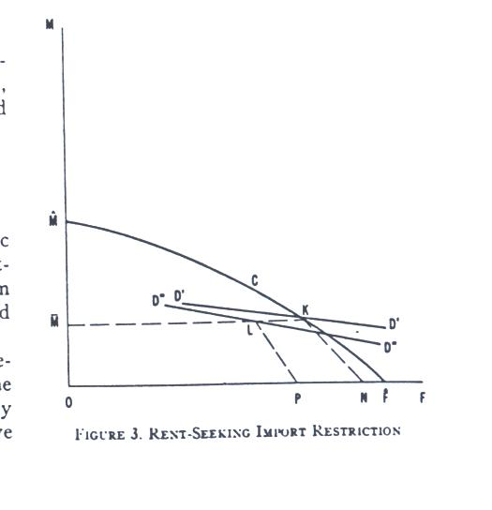

Slide 17
Implications
LR determined from (13)
With competitive rent-seeking
Equilibrium will be at a pt like L which is inside the Cons. Transformation curve MF
Imports remain at OMbar
Output of A, Cons. Of F reduced relative to case 2, D”D” is steeper than D’D’ so import price is lower

Slide 18
Appelbaum and Katz
In Krueger, there was really no political economy, the alternative cases were simply given exogenously
Appelbaum and Katz view the choice of policy regime to be the result of interaction between firms, consumer (voters) and regulator

Slide 19
Model
1. Consumers: β is prob. that cons votes for regulator β = β (W), β’ (W) >=0 (1) where W is dollar value of consumer benefit; assumed to be followers because of lack of effective collective action due to large numbers
2. Firms Compete for indivisible rent S
P_{i} =prob. that ith firm wins the rent
=αX_{i}/ [(n-1) αXbar + αX_{i}] (2)
Where Xbar is mean rent-seeking of the n-1 other firms; Α is the portion of ith firm’s expenditure that reaches the regulator. The rest (1- α) is merely wasted. (DUP activities)

Slide 20
Assume firms take Rent S as given and Cournot-Nash behavior where each firm i
Max_{Xi} [π_{i} = P_{i} (S-X_{i}) +(1-P_{i})(-X_{i}) ] (3)
From (2) Max SX_{i}/[(n-1) Xbar +X_{i}] –X_{i} (4)
FOC: δπ_{i}/δX_{i}=S(n-1)Xbar/[(n-1)Xbar +Xi]² -1=0 (5)
By symmetry all firms behave in same way. Hence:
X_{i} = Xbar =X for all i. Substituting this into (5):
Can solve for X: X = S(n-1)/n² for all firms (6)
For given no of firms n, total expenditure is
R=nX=S(n-1)/n where αS(n-1)/n is amount transferred to regulator

Slide 21
What if the Rent imposed is negative?
In this case expected profits would be
π_{i}= -P_{i}X_{i} +(1-P_{i})(S-X_{i}) (8)
Again maximizing π_{i} wrt X_{i} and imposing symmetry yields:
X = -S (n-1)/n² where S<0 (9)
Note that this is the same as (6) indicating that the solution is the same regardless of the sign of S!!!!!

Slide 22
3. Risk-neutral, self-interested Regulator
E(U)=β(W) (y+αR) + [(1-β(W)]V (10)
Where R is given by (7), y=salary of reg., V = opportunity cost of his time in regulation and
W= -S<0 which is transferred from consumer to the winning firm (11)
Assume y-V+ αR >0 so that regulator regulates. Then she chooses rent S which maximizes (10) st (1), (7), (11). She is leader who takes reaction functions of consumers and producers into account

Slide 23
Kuhn-Tucker condition for this
∂E(U)/∂S= β’(S)[y-V+α(n-1)S]/n
+β(S)α(n-1)/n <=0<=S (12)
First term on RHS is mc of S in terms of lost political support, 2nd term on RHS is marginal benefit of S on income due to extra rent-seeking by firms. FOC =
α(n-1)S/n+∂β/∂S (S/ β)[y-V+ α(n-1)S/n] <=0<=S. If y-V>0 solution must be on inelastic part of prob. Fn. If y-V<0, it must be on the elastic portion. If it is universally elastic, S=0, regulator will do nothing to jeopardize her job.

Slide 24
Some Comparative Statics
y lowers S;
V raises S;
Effects of n and α are ambiguous depending on relation of y to V
Since consumer’s welfare falls with S it rises with y-V
Regulator’s welfare rises with n, V and –y, Effect of α is ambiguous
Rise in y reduces rent-seeking and social waste
Rise in α (efficiency of rent-seeking) may not improve consumer welfare

Slide 25
Then goes on to long run equilibrium with free entry but a fixed cost c of each firm
Assume that c is distributed to consumers
Firms take S,c as given in choosing rent-seeking via same equation, n will be determined by the competityive equilibrium
Π^{l}_{i} = Sx_{i}/(n-1)Xbar +X_{i}) –(c+x_{i}) =0 for all I
Which from symmetry can be written as:
Π^{l}_{i} = S/n – c-X = 0 (18)

Slide 26
From (6), (18) can solve for x,n and R
X=Sc^{0.5}-c
R=S-(Sc)^{0.5}
n= (S/c)^{0.5}
Regulator wants to max her EU by choosing c,S taking firm and consumer reactions into account β = β(S, nc)
-, +
To get unique solution either assume heterogeneity among
voters perceptions or imposing different administrative costs on the transfer

Slide 27
Outcome of this setup in which firms are followers
In this case, Regulator uses the firms to extract rents from consumers. Firms as a group neither gain nor lose
But also specify an alternative case where sophisticated firms become the leaders and thus the firms and the regulator share the rents extracted from consumers. In this case, consumers benefit if the regulator is strong.

